Slide 1


Docker Assignment
Presented By : Akshit Kumar

Slide 2
Agenda
1. YourCreate a Jenkins pipeline to deploy application present at:
https://github.com/knoldus/node-hello
2. Required command to run the application and the ports being used are present in the Github repository.
3. The application should be containerized and should be running on docker.
4. The image has to be pushed on DockerHub and should be pulled for running.
5. The ports of the application should be open for communication and accept connection on the host machine.
6. Use any type of Jenkins project.
7. Implement use of Global Tools Configuration to use NodeJS effectively
8. Requirements:
a. Jenkins should be set up on a Cloud Virtual Machine and not from the local system
b. Any commits to the ‘main’ branch should trigger the job on Jenkins and start the build process
c. Use Github webhooks to trigger builds
d. The first part of the Jenkins job should be creating the package
e. The second part of the Jenkins job will be to send the package to another VM and run it there
9. The validations can be performed by hitting endpoints: <VM_IP>:3000 or <VM_IP>:3001e Jenkins Freestyle project to set this pipeline.

Slide 3
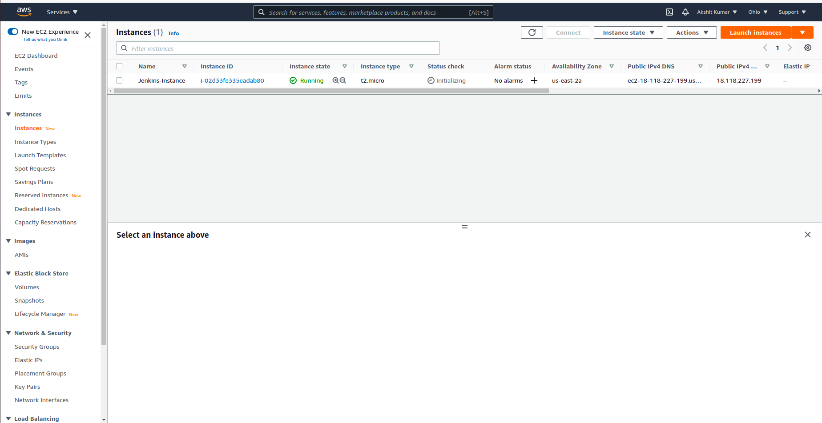
Step 1: created an AWS instance

Slide 4
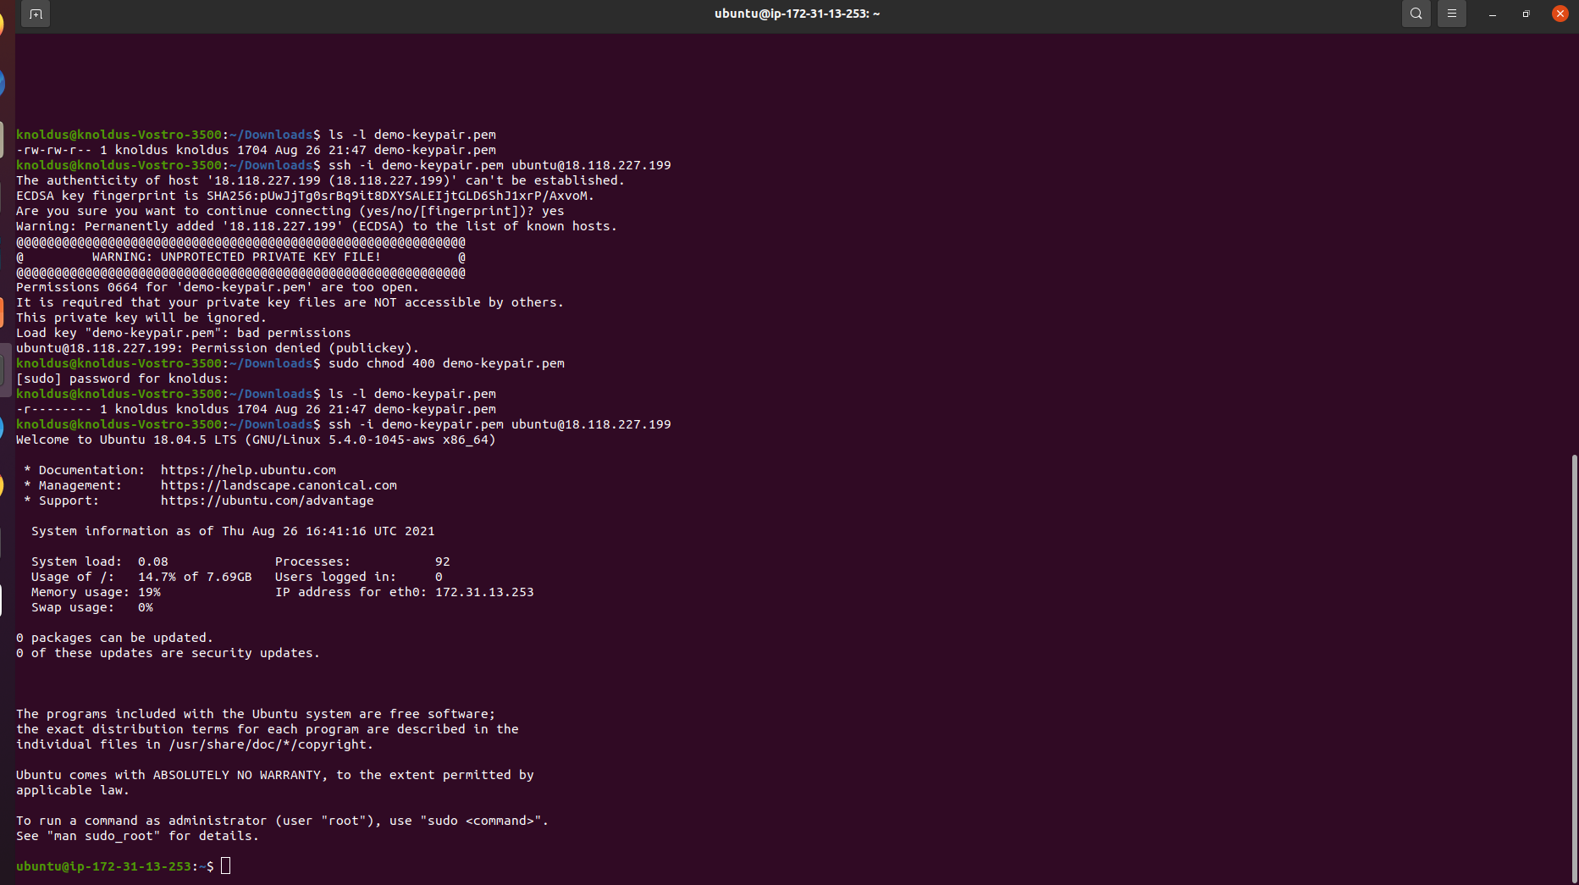
Step 2 : connecting terminal with AWS instance

Slide 5
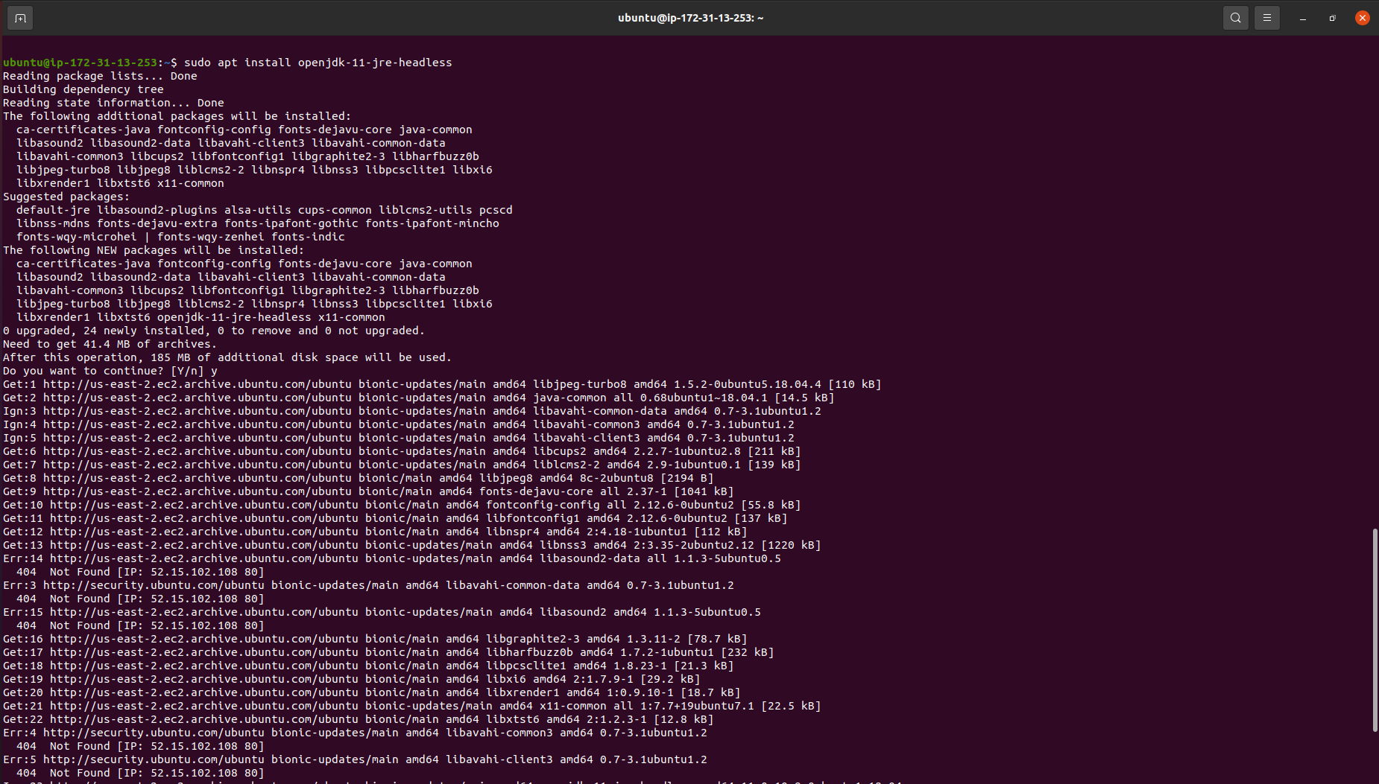
Step 3: Installing JDK

Slide 6
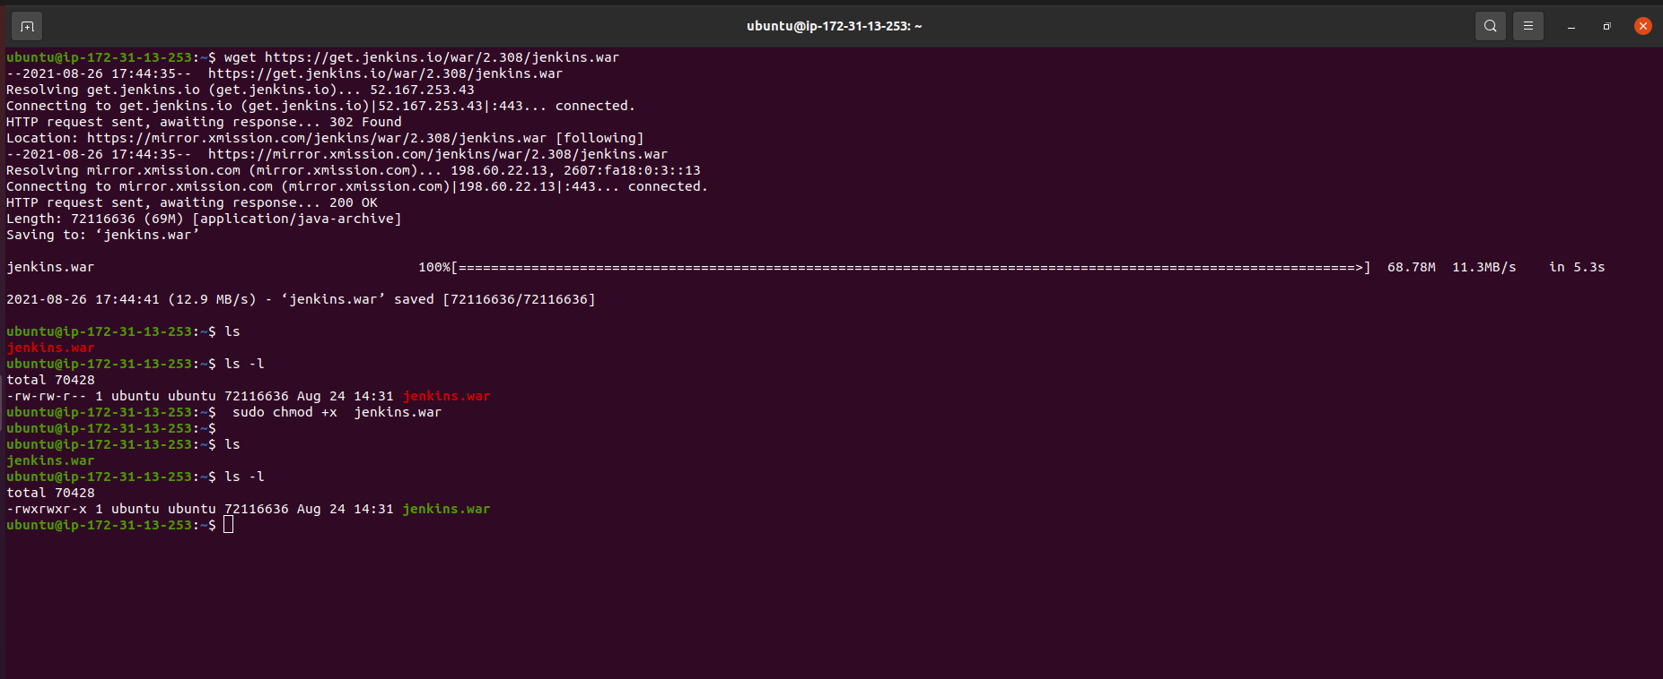
Step-4 Installing Jenkins

Slide 7
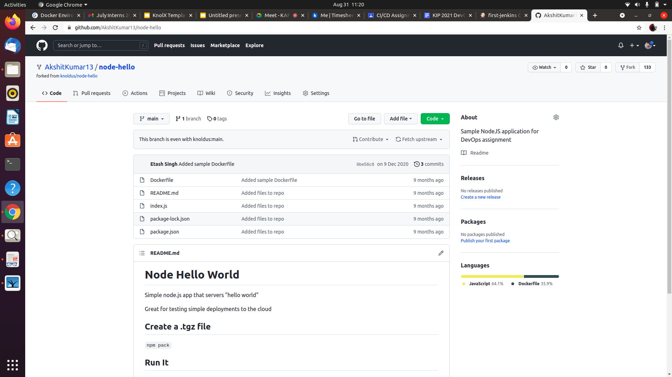
Step 5: Fork the node-hello repository

Slide 8
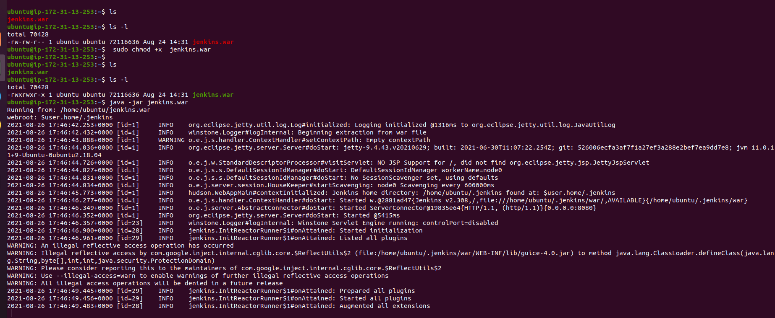
Step 6: Changing Permission

Slide 9
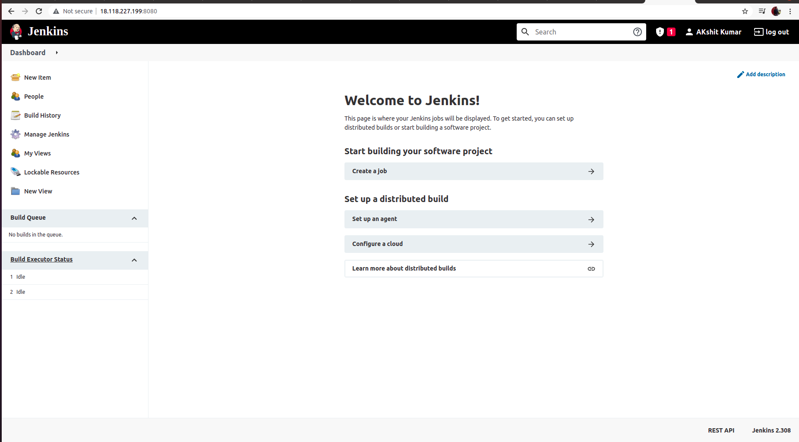
Step 7: Starting with jenkins

Slide 10
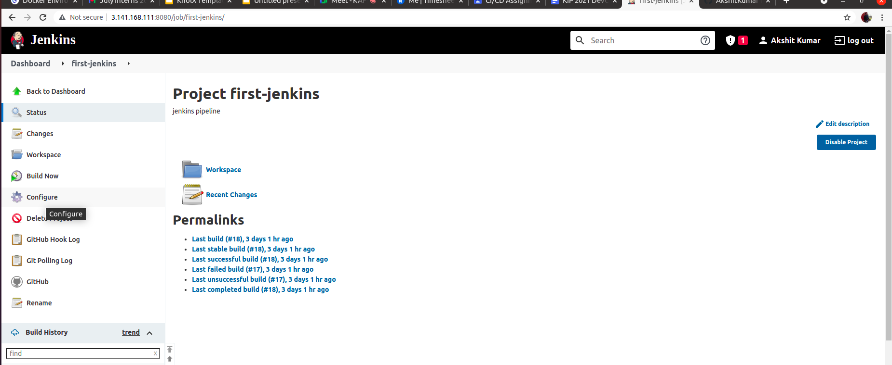
Step 8 : Conﬁgure the Jenkins pipeline

Slide 11
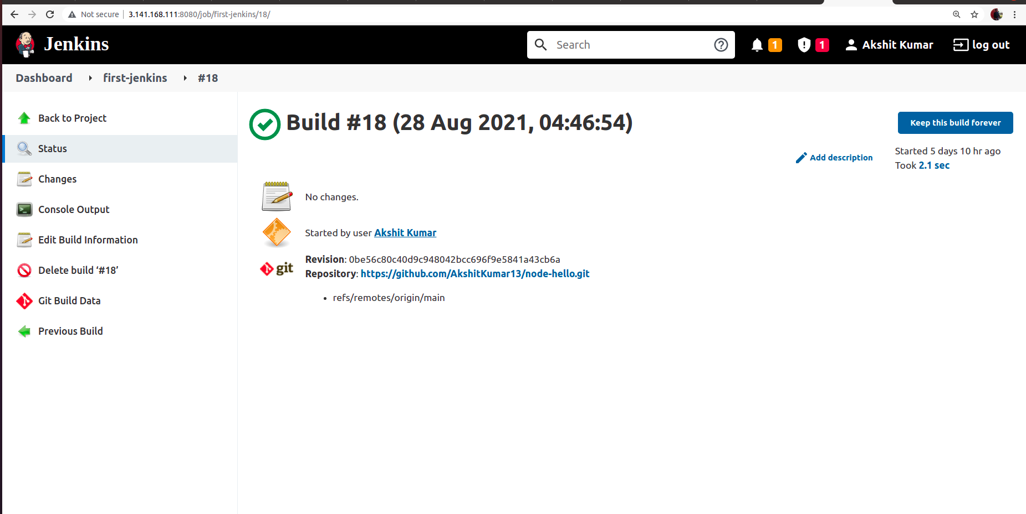
Step 9 : Build it

Slide 12
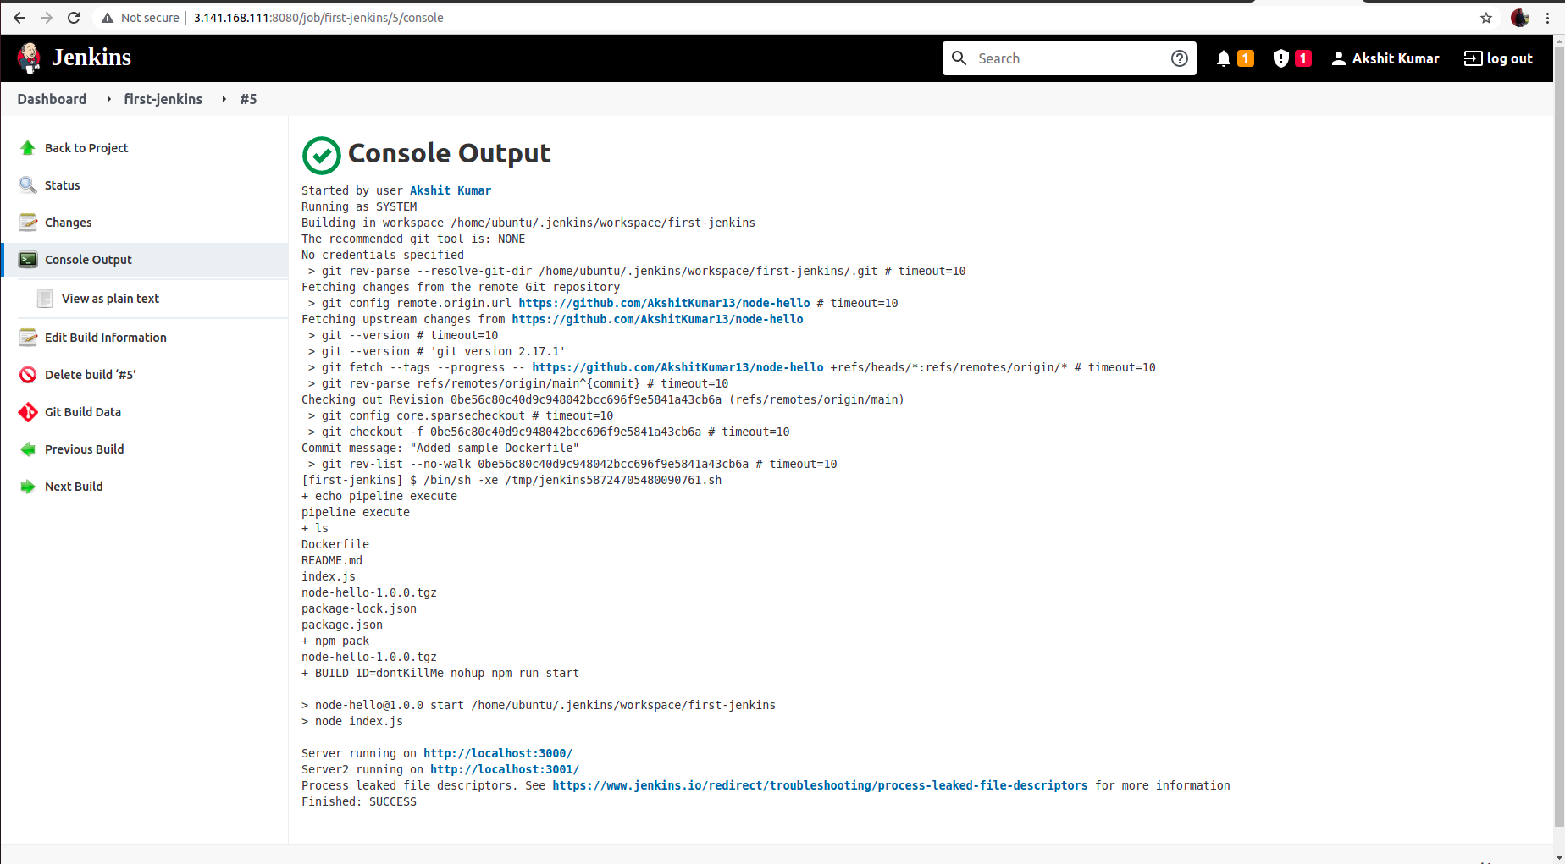
Step 10 : Check Build status

Slide 13
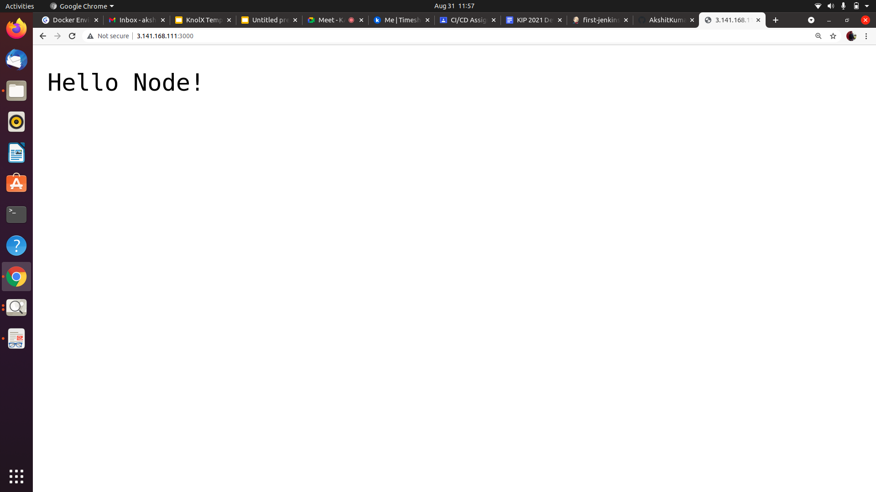
Step 11 : Finally Execute the jenkin at 3000 port

Slide 14
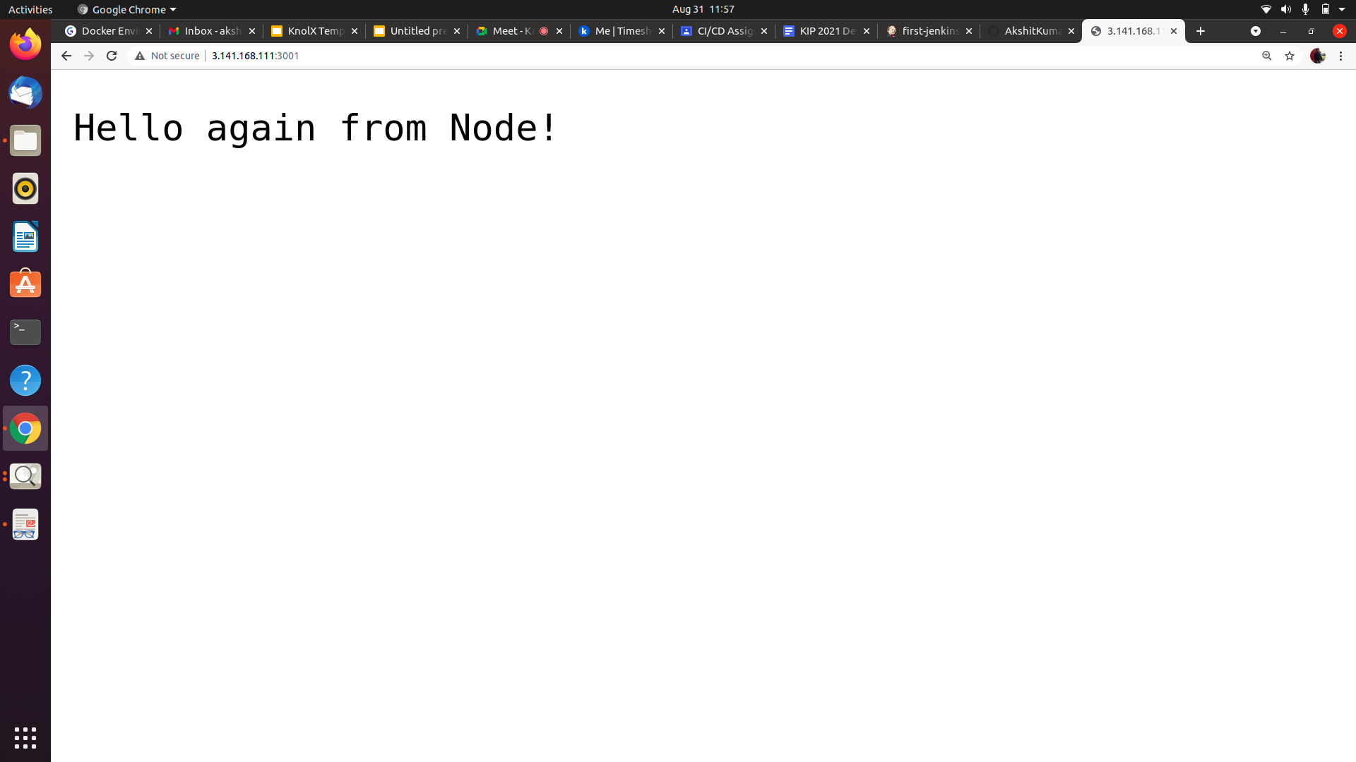
jenkin at 3001 port

Slide 15
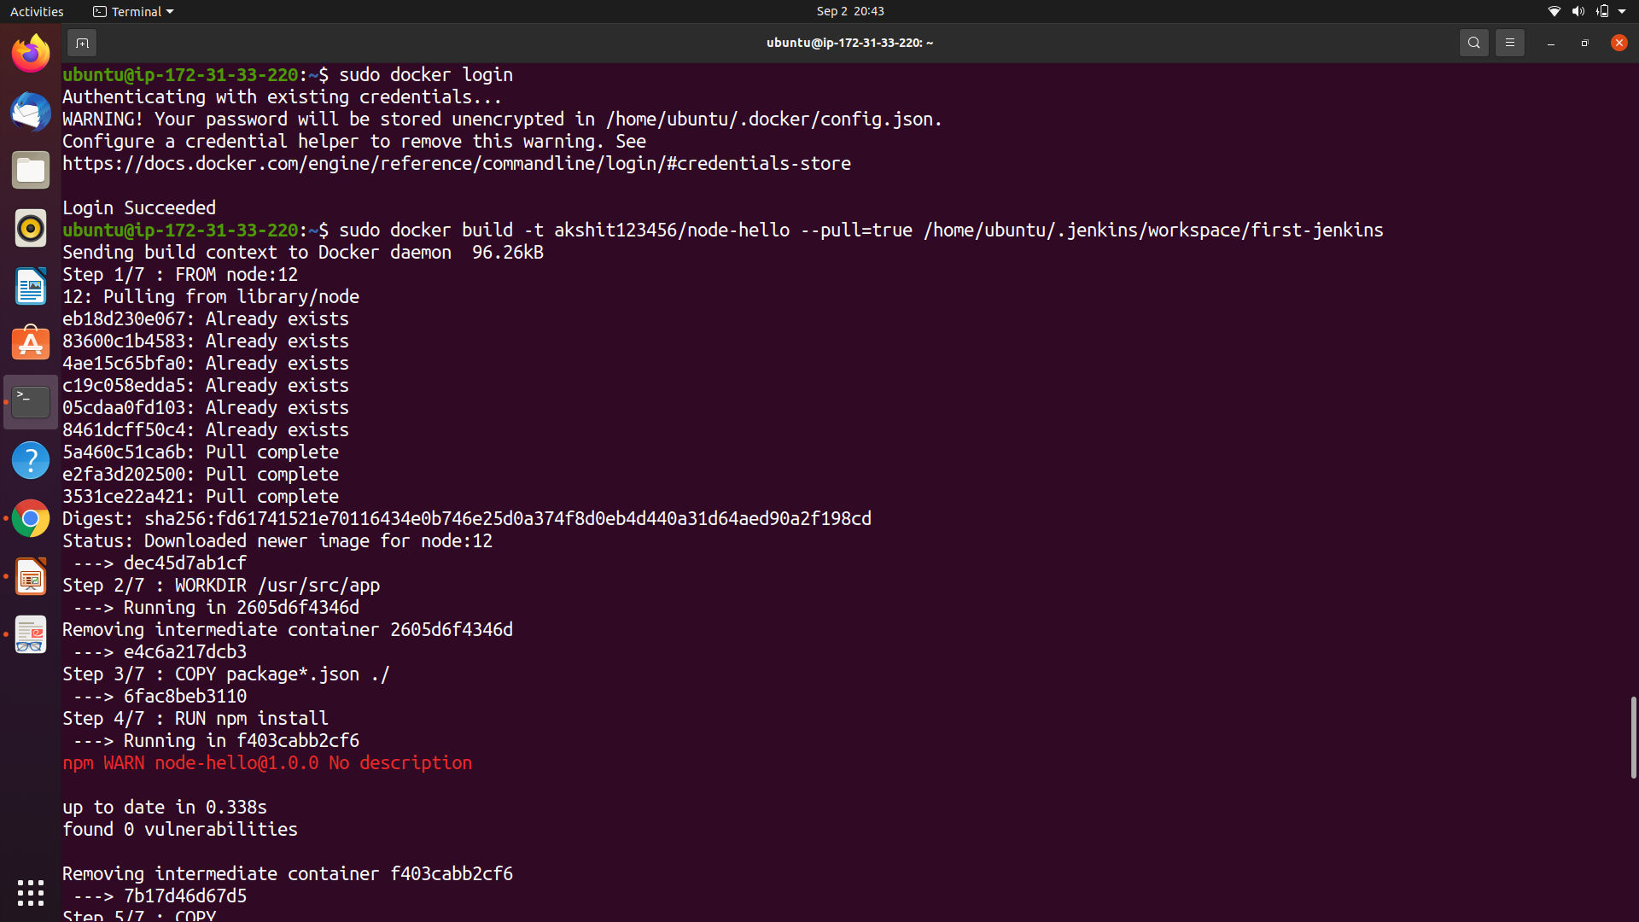
Step 12-Installed &Build Docker Image

Slide 16
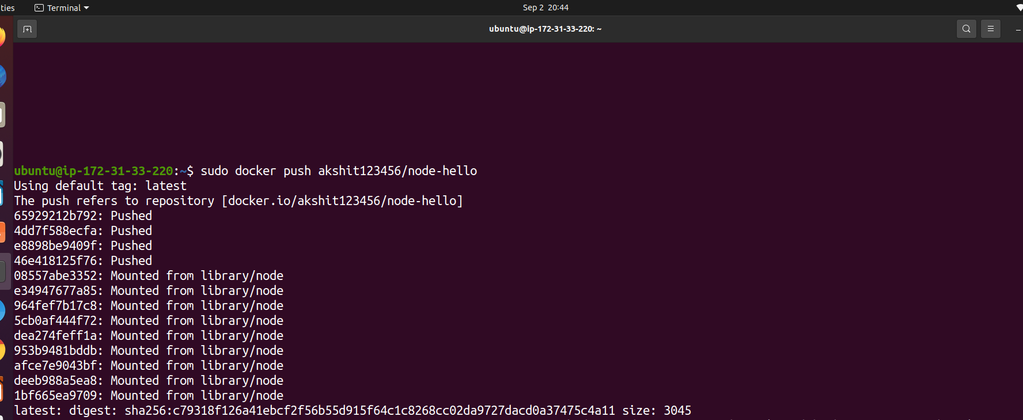
Step 13-Push Docker Image

Slide 17
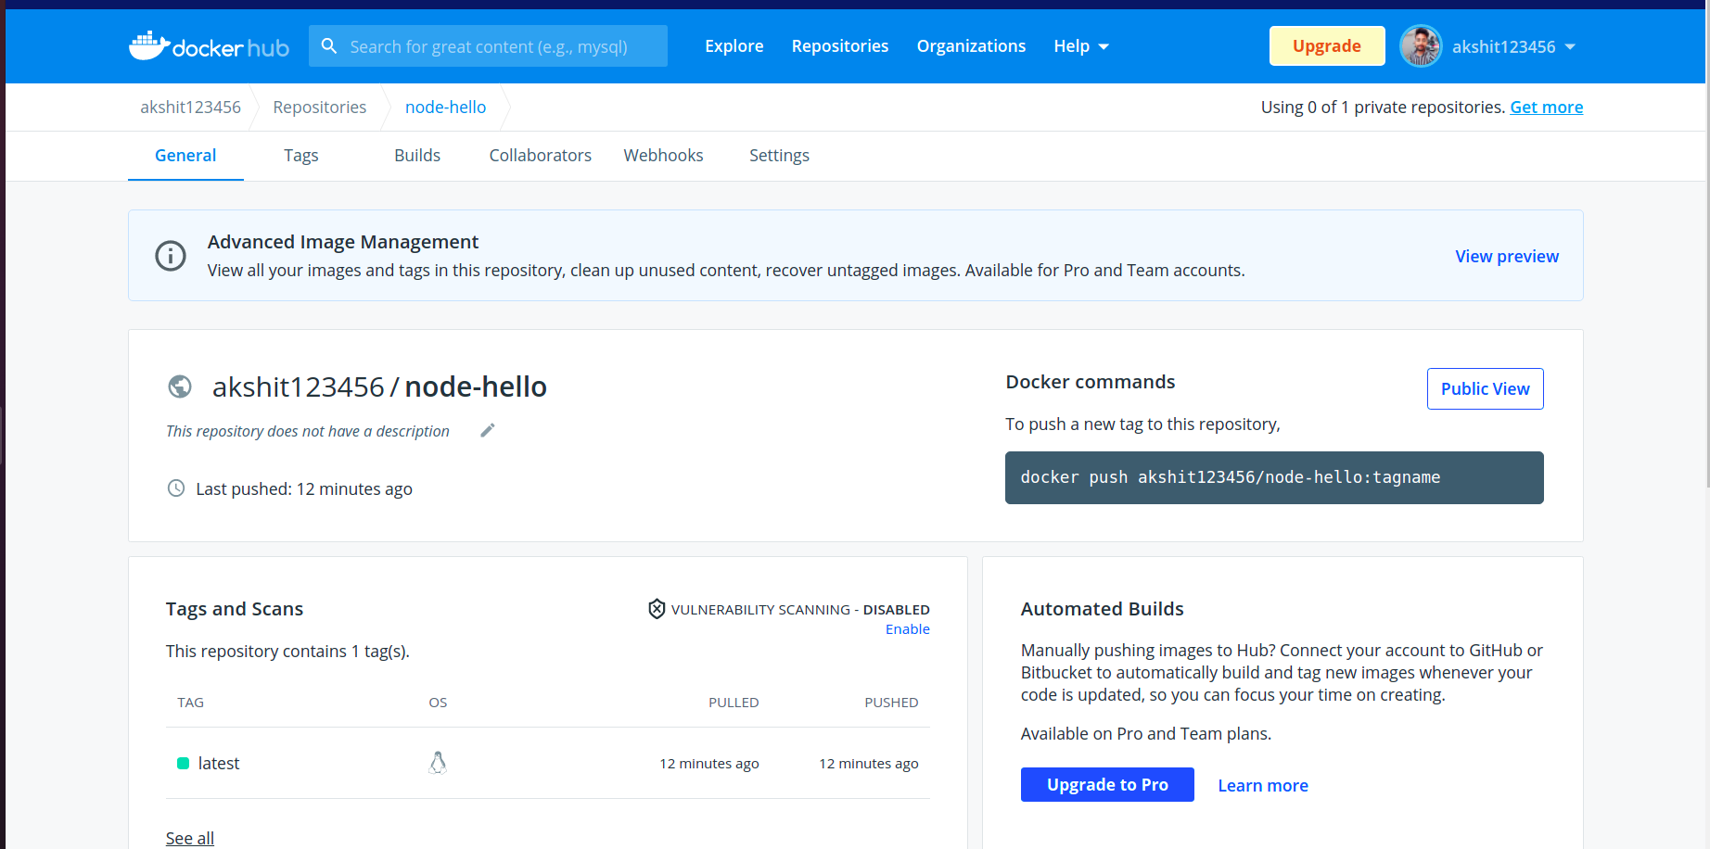
Step 14- Create proﬁle at DockerHub and push the image by terminal

Slide 18
Finally Execute the jenkin at 3000 port

Slide 19
jenkin at 3001 port url http://3.141.168.111:3001/

Slide 20
Thank You !
Notes:
<number>

